Slide 1

MutationDetector. Software tool for detecting single amino acids substitutions
Student: Brilliantov Kirill
Supervisor: Vyatkina Kira
ISSF 2019

Slide 2
Peptides and proteins
N
A
V
N
N
V
A
V
S
G
S
G
A
S
G
C
C
C
Protein
Peptides
Amino acids
1/12

Slide 3
Amino acids substitutions
A C C A A A C C G A G T
DNA strand
T
codon
Single nucleotide polymorphism
Transcription
U G G U U U G G C U C A
A
mRNA
Translation
Phe
protein
Trp
Tyr
Gly
Ser
∆M = m(Tyr) – m(Phe)
2/12

Slide 4
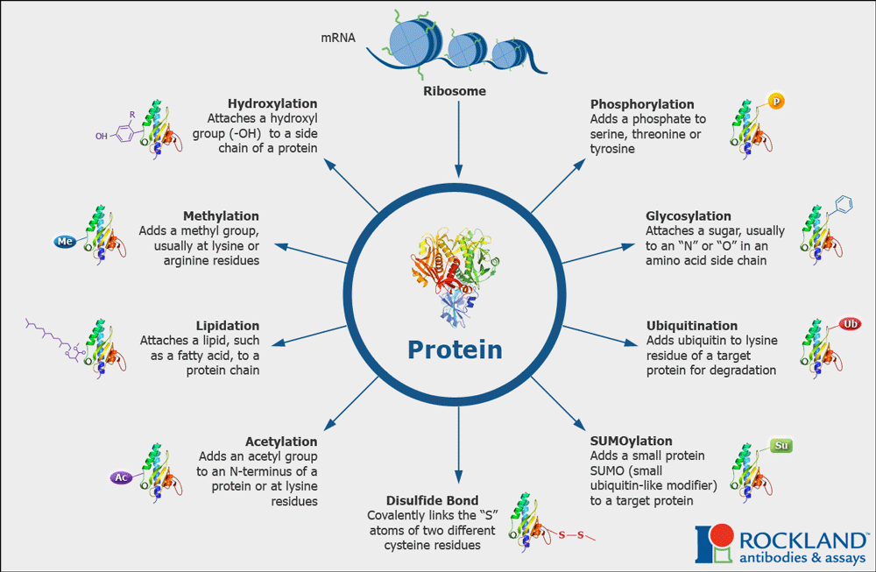
Post translations modifications
3/12

Slide 5
Possible peptide’s modifications
S
G
C
peptide
S
S
OH
L
G
C
C
a substitution
a PTM (oxidation)
4/12

Slide 6
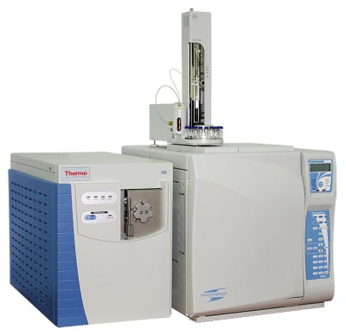
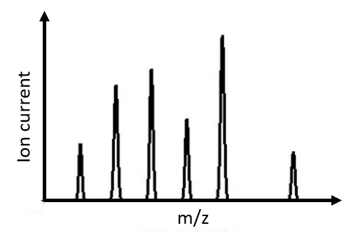
Problem statement
S
L
C
Protein
Mass spectrometer
Mass spectrum
quantity
m
Interface
File .pep
Mass spectrum
5/12

Slide 7
The Goal
To develop a software tool (ST) for analyzing data obtained from the investigated peptide.
Sub-tasks
Learn how to read a .pep file
Handle the positions in the peptide, where a PTM or a substitution could occur
6/12

Slide 8
The algorithm scheme. Input data
General | Example
<peptide> | …LTASMLAA…
<fragment which has not been modified> | SMLA
<Prefix/Suffix> | Prefix
<experimental mass of this peptide> | 4653.40152 Da
7/12

Slide 9
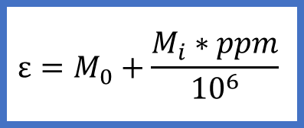


The algorithm scheme
$$ε=\frac{M_{i}∗ppm}{{10}^{6}}$$
Prefix
Find a PTM or a sub with
∆m $∈$
$(\text{∆}$M – ε; $\text{∆}$M + ε)
For each position
Count the error:
Suffix
$$ε=M_{0}+\frac{M_{i}∗ppm}{{10}^{6}}$$
7/12

Slide 10
The output
View of sequence in ST
Structure of .pepout file
V Q S S S A R C V N G N
General | Example
<peptide> | YASSRSPHAIQPQAP...
<Prefix/Suffix> Selected | Prefix selected
at position(s) <numbers>: <sub/PTM> | at positions 11, 17: A>>V
… | at positions 13, 16: Q>>R
- PTM
- both
- substitution
8/12

Slide 11
Interface
9/12

Slide 12


Slide 13
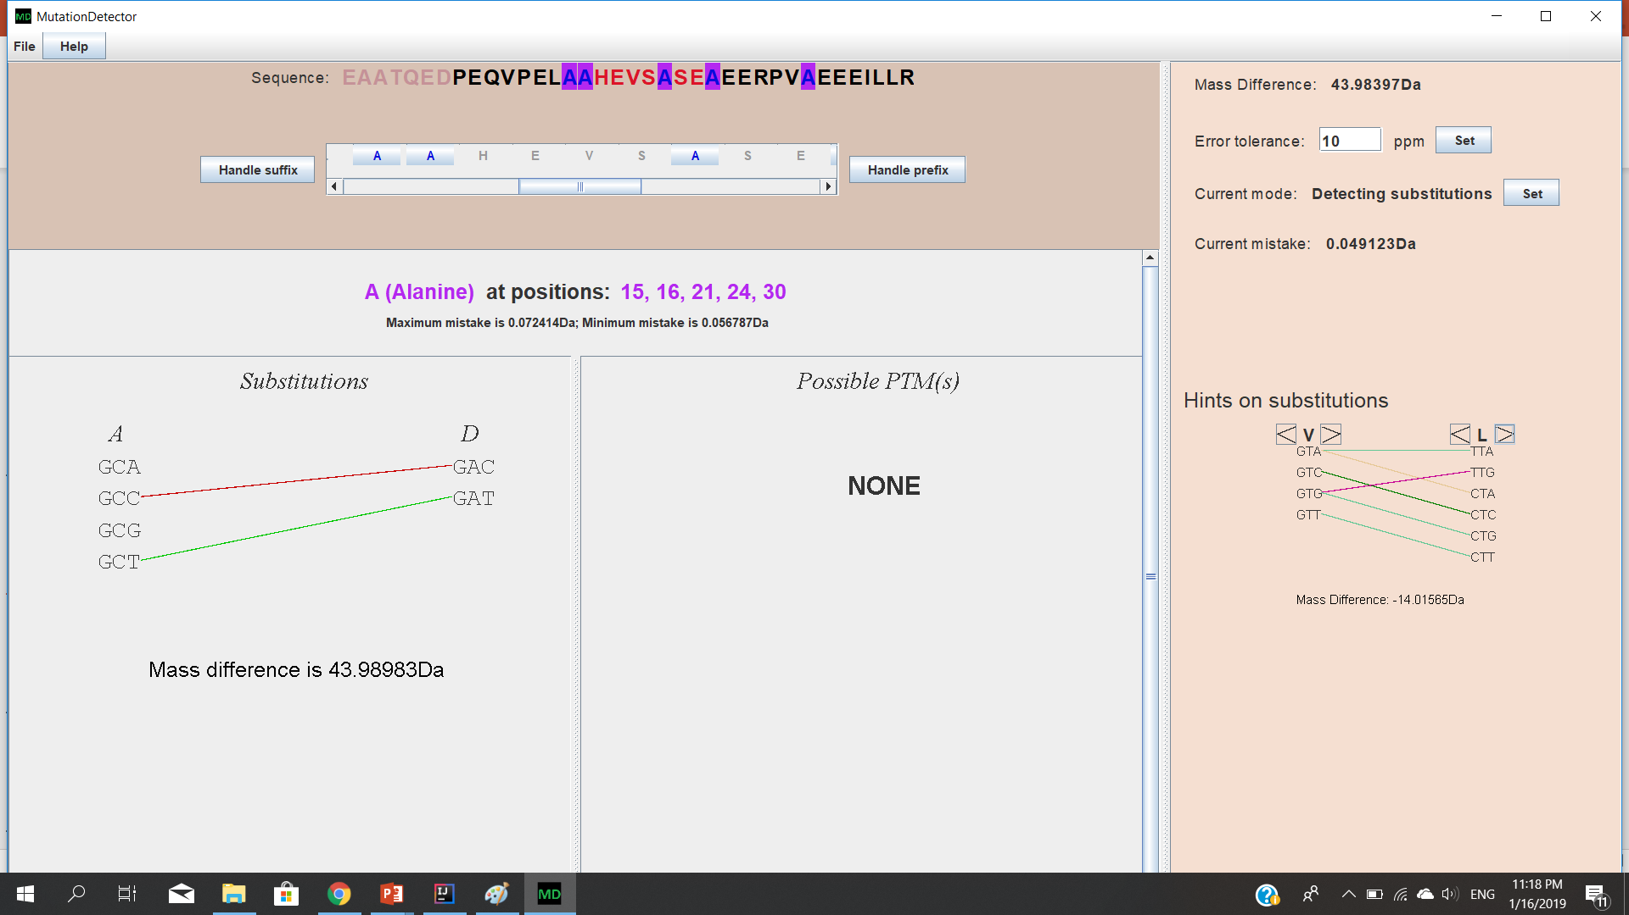
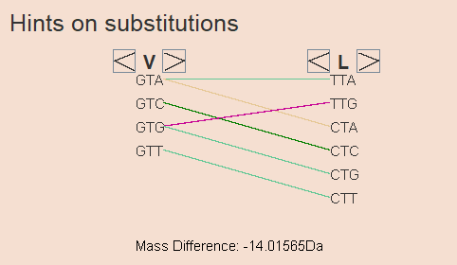
Interface. The general view
10/12

Slide 14
Interface. Testing
YASSVRSPHPAIQPLQAPQPAVHVQGQEPLTASMLAAAPPQEQK
In this peptide, two substitutions A->V and Q->R occurred
(in the prefix).
2. EAATQEDPEQVPELAAHEVSASEAEERPVAEEEILL
In this peptide, a substitution A->V occurred (in the suffix)
In either cases, MutationDetector provides as output a correct result.
11/12

Slide 15
Conclusions
The software tool has been developed
It was tested on a melanoma cancer cell line, and demonstrated correct behavior
We intend to extend the functionality of MutationDetector in order to solve more specific problems
Open source code:
https://github.com/KirillBrilliantov/BioInformatics
Thank you for your attention
12/12

Slide 16
References
B. Lewin. Cells. BINOM Russia, 2011. 951 с.
S. Nie, H. Yin, Z. Tan, M. A. Anderson, M. T. Ruffin, D. M. Simeone, D. M. Lubman. Quantitative Analysis of Single Amino Acid Variant Peptides Associated with Pancreatic Cancer in Serum by an Isobaric Labeling Quantitative Method. J Proteome Res. 2014, 13(12):6058–6066.
X. Liu, Y. Inbar, P. C. Dorrestein, C. Wynne, N. Edwards, P. Souda, J. P. Whitelegge, V. Bafna, P. A. Pevzner. Deconvolution and database search of complex tandem mass spectra of intact proteins: a combinatorial approach. Molecular and Cellular Proteomics, 9:2772-2782, 2010.
K. Vyatkina, S. Wu, L. J. M. Dekker, M. M. VanDuijn, X. Liu, N. Tolic, M. Dvorkin, S. Alexandrova, T. M. Luider, L. Pasa-Tolic, P. A. Pevzner. De Novo Sequencing of Peptides from Top-Down Tandem Mass Spectra. J Proteome Res. 2015, 14(11):4450-4462.
K.V. Vyatkina, A.A. Lobas, L.I. Levitsky, M.V. Ivanov, E.M. Solovyeva, S.A. Moshkovskii, M.V. Gorshkov. Automated detection and validation of variant peptides in cancer cell lines via de novo sequencing assisted database search. Proc. 5th International Conference “POSTGENOME’2018” “In Search of Models for Personalized Medicine”, Kazan, Russia, October 29- November 2, 2018, pp. 41-42.

